Slide 1
The Rising Influence of Computer-Written Content
Tristan Searle
6/12/2019

Slide 2
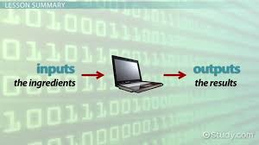
Introducing algorithms
Algorithms are a set of rules a computer follows to perform a function.
Notes:
The output of an algorithm (whatever task it ends up performing or content it produces) is often based on the input received (whatever is given to the algorithm to help it perform its task).

Slide 3

Computer-writing algorithms
Algorithms can be programmed to produce articles, essays, and even short stories.
Notes:
Although the quality of the written content produced by algorithms is less readable and “beautiful” than that produced by people, it can be done much faster (in some cases, even in seconds).

Slide 4



writing programs in journalism
Journalism is one field that is particularly geared towards the application of writing programs.
Notes:
The Associated Press started using robo-writers in August 2014 to generate thousands of financial reports, while Forbes and The Los Angeles Times have been using them to generate news stories for even longer.

Slide 5


“Reporting has not yet reached the stage where journalists are ready to be integrated with machines,” David P. Kowal, a communications expert and president of Kowal Communications Inc., states. “But an acceptance of robo-copy in newsrooms across the country seems inevitable.”

Slide 6
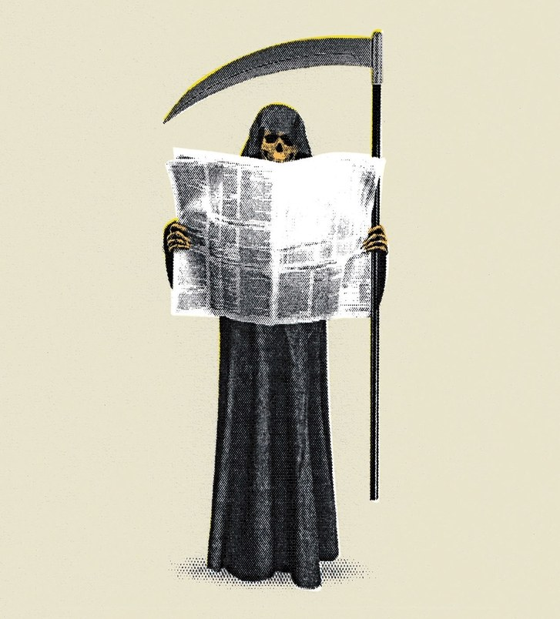
The death of human journalism?
News sources such as Buzzfeed have experienced major lay-offs.
Notes:
This is due in part to the public being fed up by recent trends in the media to report either inaccurate or biased stories.
A larger factor, however, may be that recent developments in the efficiency of writing programs allow publishers to rely on technology instead of people.

Slide 7
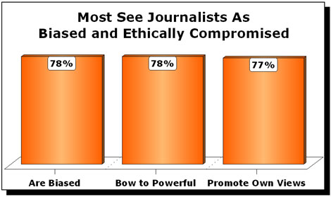

Potential Benefits to replacing journalists with computers
Some people feel like a shift towards automated journalism can prevent bias, helping present facts more accurately and objectively.
Notes:
Additionally, algorithms don’t require salaries, health insurance, etc., and can get a lot more done in a lot less time. From the standpoint of a business trying to be as profitable as possible, the benefits to replacing people with algorithms are quite numerous.

Slide 8
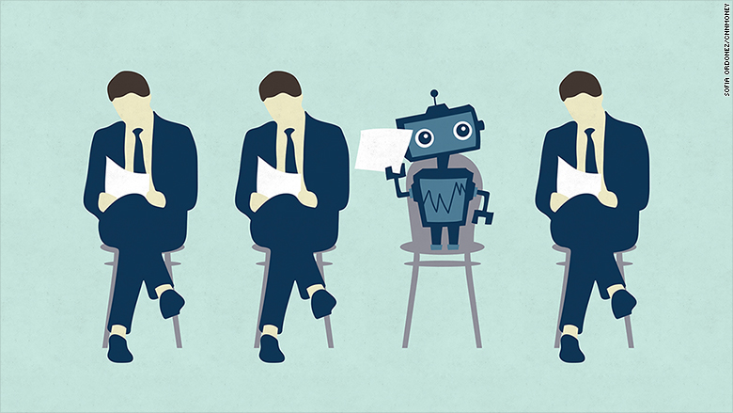
Potential disadvantages of replacing journalists with computers
The loss to human livelihood is the greatest pitfall of replacing humans with technology when it comes to writing news articles.
In strong contrast to the idea that computers would make reporting more objective, some have pointed out the dangers in relying on algorithms.
Notes:
-People lose their jobs, and likely face a hard time replacing them.
-One of the most essential aspects of writing, the human connection readers feel, is lost.
-Algorithms can be programmed to subtly reflect biases that affect the subconscious interpretation of the reader.
-Algorithms often scour the writing of people to help them determine a thematic and syntaxial approach; by doing so, they may unwittingly absorb negative ideologies or false facts.

Slide 9



Impact on creative writing
As of 2019, computer programs are still a long way from being able to replicate standards most editors ascribe to when considering the quality of a short story, poem, or novel.
Notes:
Jeff Mullin, senior writer at News & Eagle, puts it eloquently: “Can a computer describe the beauty of a sunset, impart the pain of loss, capture the sound of a baby’s laugh, tell the story of lives shattered by a tornado, detail the joy of a soldier reunited with his family, suss out when there is more to the story than officials are letting on.”

Slide 10
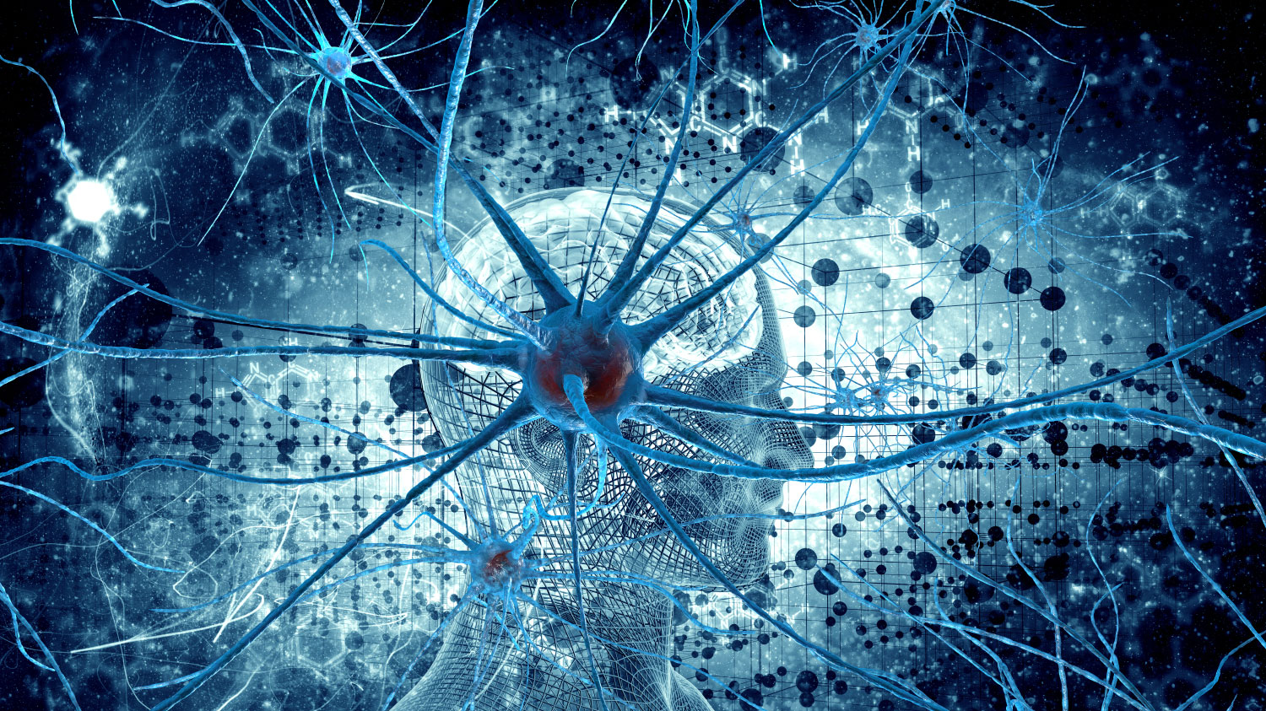
The flipside of Algorithms and creative writing
Creative writing may not be safe forever.
Although human input is still required to craft stories, the technology will continue to advance.
Notes:
For now, at least, humans are needed for these processes to go well. Although if programmers continue to improve their craft, while creative writers pretty much stay the same as they always have, the publishing industry won’t be safe from computer influence forever.

Slide 11
overview
Computer algorithms that can produce writing and mimic a human voice are increasing in complexity and prevalence.
Many news sources have already begun the transition to primarily using algorithms to produce news stories.
There are both advantages and disadvantages to this transition.
While human journalism is being threatened, the prevalence of human-based creative writing is a trend that will likely continue for a long time.
Notes:
Conclusively, there is no real way to tell exactly how computer-written content will affect the future. Shelley Podolny, a director of a company called H5 and a writer on electronic information issues, has this to say on the matter: “With technology, the next evolutionary step always seems logical. That’s the danger. As it seduces us again and again, we relinquish a little part of ourselves.” By sacrificing the human aspect of writing, people sacrifice the thing that makes writing special and worthwhile in the first place. Only time can tell where this slippery slope will lead.

Slide 12
Questions?

Slide 13
Image bibliography
Slide 2: https://study.com/academy/lesson/what-is-an-algorithm-in-programming-definition-examples-analysis.html
Slide 3: https://www.pewinternet.org/2017/02/08/code-dependent-pros-and-cons-of-the-algorithm-age/
Slide 4: forbes.com, latimes.com, https://www.ap.org/en-us/
Slide 5: https://www.cnn.com/2019/01/25/media/buzzfeed-news-division-layoffs/index.html, https://www.nytimes.com/2019/05/03/business/media/school-newspaper-porn-article.html
Slide 6: https://medium.com/@shkendiezeciri/is-the-role-of-social-media-helping-or-hurting-journalism-today-1af7432828e0
Slide 7: https://www.mrc.org/media-bias-101/exhibit-2-3-asne-journalism-credibility-project-1998, https://niemanreports.org/articles/how-implicit-bias-works-in-journalism/
Slide 9: tourismalternative.blogspot.com, youtube.com, fortune.com
Slide 10: https://futureoflife.org/2015/11/23/the-superintelligence-control-problem/

